Slide 1
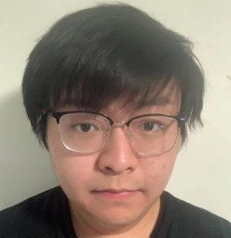
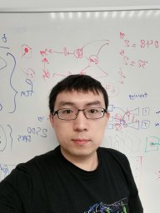
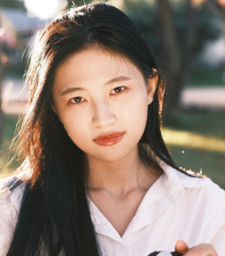
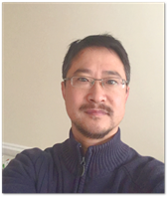
Blind Image Decomposition
Junlin Han Weihao Li Pengfei Fang Chunyi Sun Jie Hong Ali Armin Lars Petersson Hongdong Li
Notes:
Hi I‘m Junlin Han, I will introduce our work Blind Image Decomposition.

Slide 2
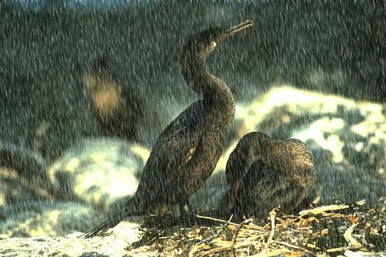
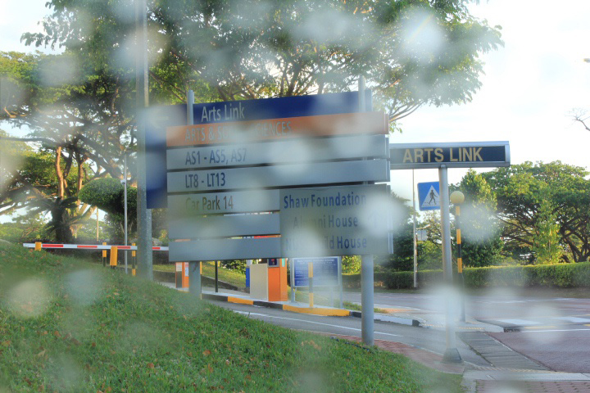
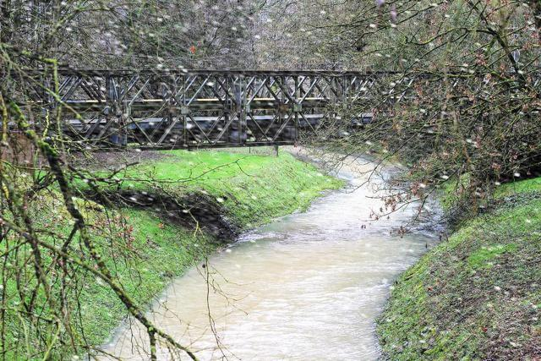
Rain Streak
Rain Drop
Snow
Haze
The many faces of rain
Notes:
First, I’d like to raise a question, what is rain? In most time, we think rain exists as rain streak.
In a driving environment, when we look through the glass, rain may also exist as rain drops.
What else may come along with rain? When the temperature is under some conditions, the falling precipitation can be snow.
And do not forget haze, which also comes along quite often with raining.

Slide 3
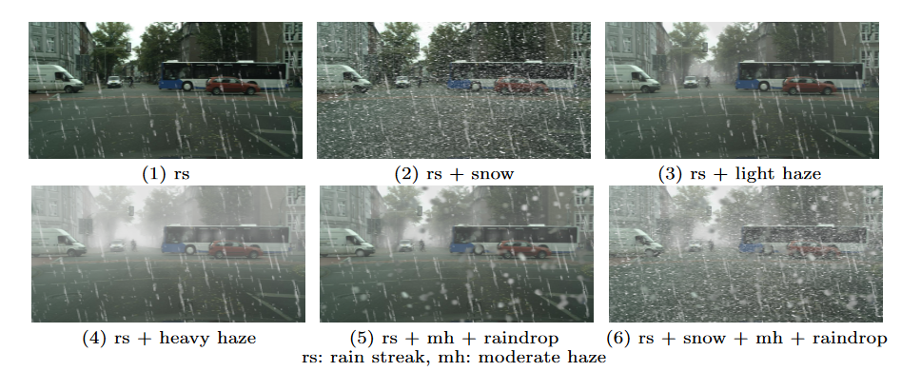
Rain as arbitrary combinations
Notes:
The aforementioned four components may occur solely, or as an arbitrary combination in real-world. We need to consider the existence and intensity of every component. When we talk about raining, it can be one of these 6 cases presented here.

Slide 4
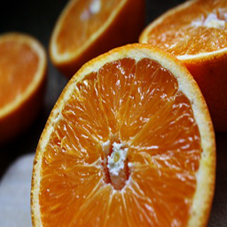
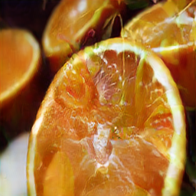
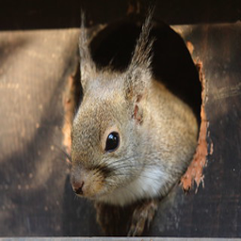
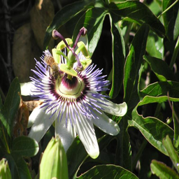
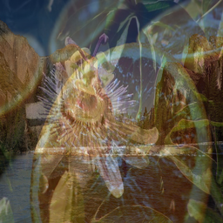
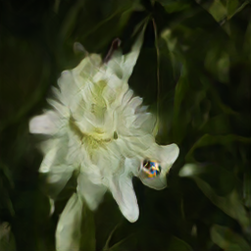
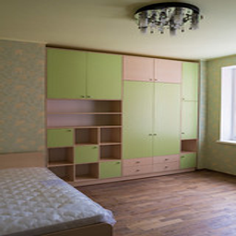
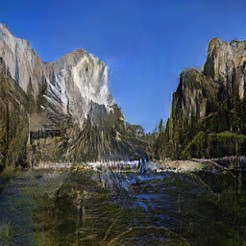
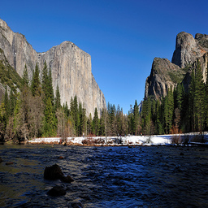
123
Fruit
Arbitrary Combination
Animal
Separate and Reconstruct
Mix
Method
Flower
Furniture
Select
[1,0,1,0,1]
Yosemite
Predict
Notes:
Here is a demo of the Blind Image Decomposition setting. We pre-define some source components containing images of a certain class. We randomly choose images from different sources, then mix them. We want to have a method to predict the sources involved in mixing, as well as separate and reconstruct individual images involved in mixing.

Slide 5
Task format
Goal of Blind Image Decomposition method:
1: Predict the components involved in mixing.
2: Separate and reconstruct individual images involved in mixing.
Notes:
The goal of BID task can be summarized using two key words, predict and separate, where we want to a model to predict the components involved in mixing and separate individual images involved in mixing.

Slide 6
Blind Image Decomposition Network
We design a simple yet general, and flexible model, dubbed BIDeN (Blind Image Decomposition Network)
Notes:
As BID is a novel task, we designed a simple yet general, and flexible model to perform all kinds of BID tasks. Our model is named BIDeN, which is short for Blind Image Decomposition Network. The design of BIDeN is based on GANs, we introduce a multiple-scale encoder, and multiple heads corresponding to each source component to perform the separate and reconstruct task. The source prediction task is performed in the Discriminator.

Slide 7
Benchmark datasets
To facilitate research on BID task, we construct three benchmark datasets, including:
I: Mixed image decomposition across multiple domains.
II: Real-scenario deraining.
III: Joint shadow/reflection/watermark removal.
Notes:
Let’s look at BID datasets. We built 3 BID datasets in total. In this talk, we will focus on the later two datasets and their BID tasks.

Slide 8
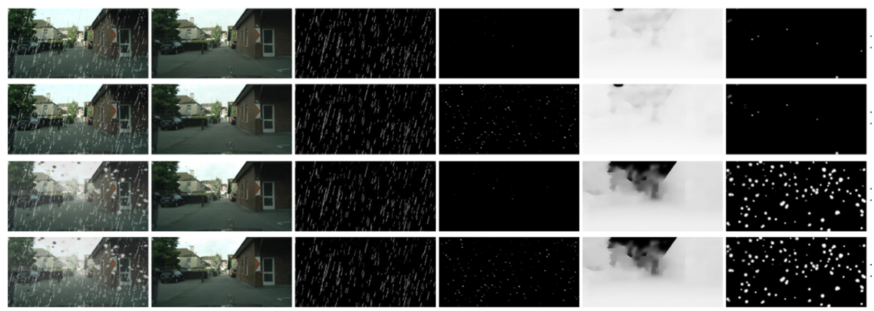
Task II.A: Real scenario deraining in driving
Notes:
Task II.A is deraining in driving. Deraining task can be important in a driving environment, we employ cityscape as rain-free images. Other components are rain streak, raindrop, haze, and snow. We follow the physical imaging model to generate raining images.

Slide 9
Task II.A: Real scenario deraining in driving
BIDeN performs well with most source components
Notes:
Here we present the results of BIDeN on 6 testing cases. Except for raindrop masks. BIDeN overall performs well on all source components, and shows very high accuracy in the source prediction task.

Slide 10
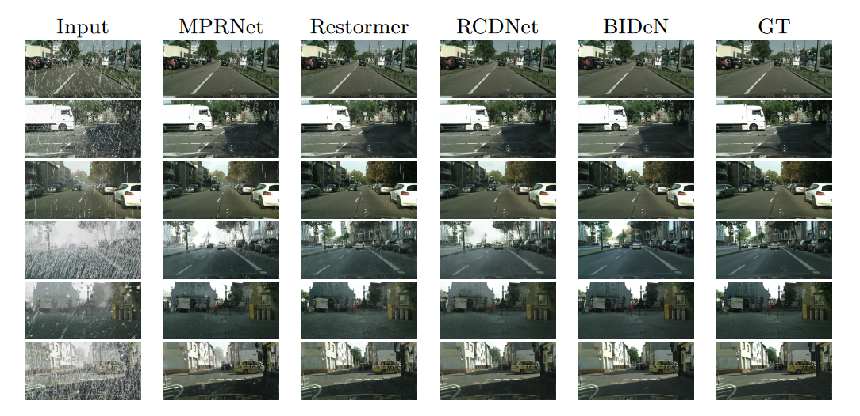
Task II.A: Real scenario deraining in driving
Row 1-6 presents 6 cases
BIDeN removes all distortions
Notes:
Here are some visual results of BIDeN and other baselines. Baselines are also trained in the BID setting. We can see that BIDeN is good with all components, while strong baselines like MPRNet and Restormer sometimes can not remove raindrop and haze.

Slide 11
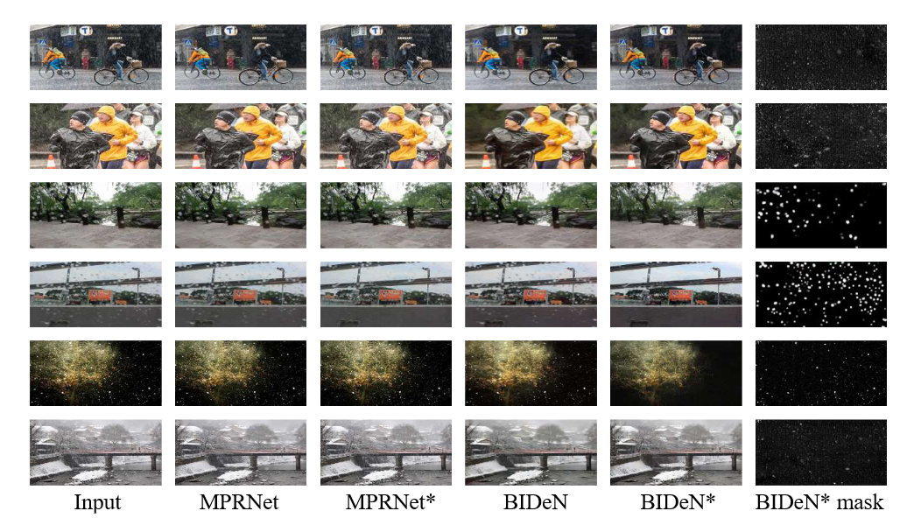
Task II.B: Real scenario deraining in general
* Indicates the BID setting BID setting is more robust
Notes:
Taks II.B aims to compare the BID training setting and conventional image decomposition setting. Here we show some visual results of MPRNet and BIDeN on real images. Both MPRNet and BIDeN are trained with conventional image decomposition setting and BID setting. In the conventional setting, we train models with 4x more data and training iterations than the BID setting. In summary, models trained under the BID setting are more robust in restoring real-world images.

Slide 12
Task II.B: Real scenario deraining in general
* Indicates the BID setting BID setting better adapts to real-world
Notes:
Quantitative results further validate the generality and robustness of the BID setting in real-world scenarios. Models trained under the BID setting are good at processing all kinds of natural images.

Slide 13
Task III: Joint shadow/reflection/watermark removal
Images and masks (Shadow, Watermark) produced by BIDeN for three cases, (a), (c), and (abc).
a: shadow
b: reflection
c: watermark
Notes:
Task III is designed to jointly perform multiple tasks with uncertainty in one go, which is an attempt towards a unified model for various low-level vision tasks. We have shadow, reflection, and watermark in this task. We follow the physical imaging model to generated mixed images.

Slide 14
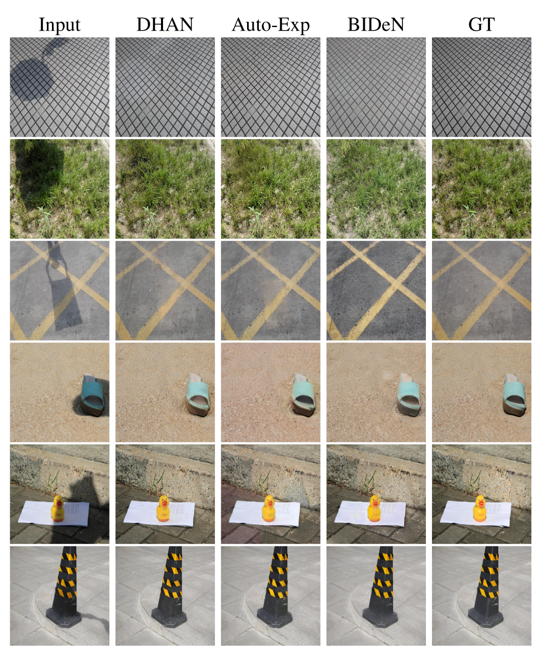
Task III: Joint shadow/reflection/watermark removal
Qualitatively BIDeN performs well on shadow removal task.
Notes:
In this task, baselines are trained in the shadow removal setting. Though not as good as strong baselines designed for shadow removal task, BIDeN still shows reasonable results.

Slide 15
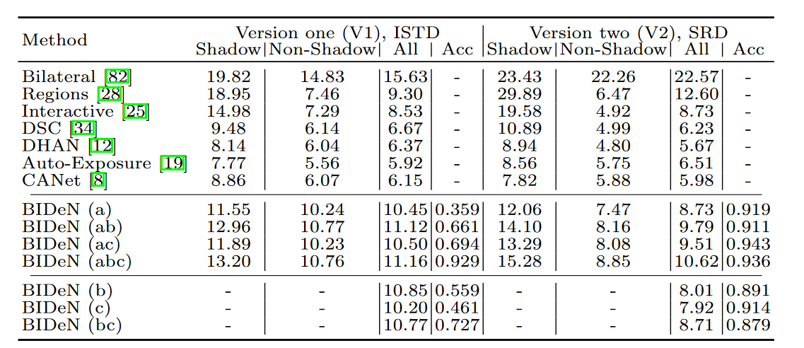
Task III: Joint shadow/reflection/watermark removal
Testing cases:
a: shadow
b: reflection
c: watermark
BID setting is challenging!
Notes:
We compare BIDeN to other shadow removal baselines. BIDeN trained under the BID setting show lower results than those shadow removal baselines, which suggests the BID training setting can be very challenging.

Slide 16
Conclusion
A new low-level vision task that better adapts to complex real-world environments, with multiple benchmark datasets available for future explorations.
It’s beneficial to treat source components as arbitrary combinations.
Codes and datasets: https://github.com/JunlinHan/BID
Notes:
In conclusion, we propose a new task that better adapts to complex real-world environments. Codes and datasets of this paper are all available. Thanks for your attention.

